Slide 1
MAG Homeless Outreach Viewer
Nicole Funicello
Notes:
I am a GIS analyst in the Regional Analytics Division at Maricopa Association of Governments.

Slide 2
Maricopa Regional Continuum of Care (CoC)
Designed to promote communitywide commitment to the goal of ending homelessness
Provides funding for State and local governments to quickly rehouse homeless individuals and families
https://www.azmag.gov/Committees/Policy-Committees/Maricopa-Regional-Continuum-of-Care-Board
Notes:
MAG is the lead agency for the Maricopa Regional Continuum of Care- a federal program designed to promote communitywide commitment to the goal of ending homelessness.
I work closely with the Human Services Division at MAG to provide GIS support to the Continuum of care programs that they manage-all of which have or will be affected by the Covid-19 pandemic.

Slide 3
CoC Response to Covid-19
Quarantine referrals providing isolation and recovery for those with acute COVID-19 symptoms or with COVID-19+ status
Isolation for persons under investigation (PUI) due to exposure or the presences of minimal symptoms
Prevention for those at high risk of severe complications from the virus.
https://www.azmag.gov/Programs/Homelessness/Homeless-Services-Maricopa-Regional-CoC-COVID-19-Response
Notes:
The Maricopa Regional Continuum of Care is working with the County Health Department to issue screening and referral pathways to identify three areas of focus for the community response to the COVID-19 outbreak:
(Check out the CoC’s Covid19 Response webpage to see an awesome interactive chart my colleague Maggie Wong developed to track at risk Clients Served in the Past Week by Program Type)

Slide 4
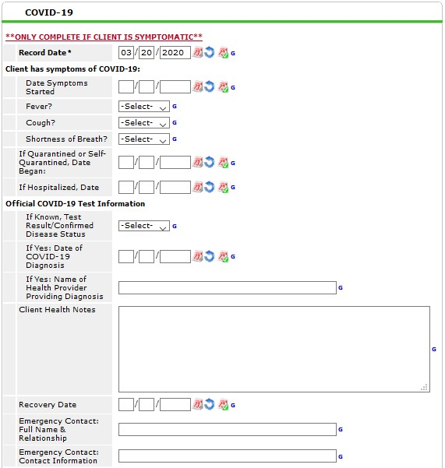
Homeless Management Information System (HMIS) Database
Client level
Tracks services received
Used for federal reporting
https://hmisaz.org/
Notes:
Identifying, tracking and quantifying at risk clients is possible with the Homeless Management Information System.
HMIS is a database used to collect client-level data and data on the provision of housing and services to homeless individuals and families and persons at risk of homelessness and used for federal reporting.
Clients who have received services are registered into the database and by querying for ages 60 and over along with a chronic health condition flag, “at risk” clients can be identified. COVID-19 assessment fields were added in March.

Slide 5
Notes:
Now we can talk about the Homeless Outreach Viewer!
The Outreach Collaborative is a subgroup of the Maricopa Regional Continuum of Care. The collaborative is made up of Homeless Outreach Providers who meet monthly to coordinate regional outreach efforts.
In 2018, one of the providers became aware of latitude/longitude capabilities within HMIS during a training. They began implementing Outreach geotagging in Maricopa County and encouraged other providers to do the same. MAG was enlisted to create a password protected online viewer displaying the outreach locations and incorporating filtering along with selection capabilities.
The Outreach viewer has proven to be a useful tool in coordinating outreach efforts throughout the region and now has 33 Street Outreach teams contributing geotagged locations.

Slide 6
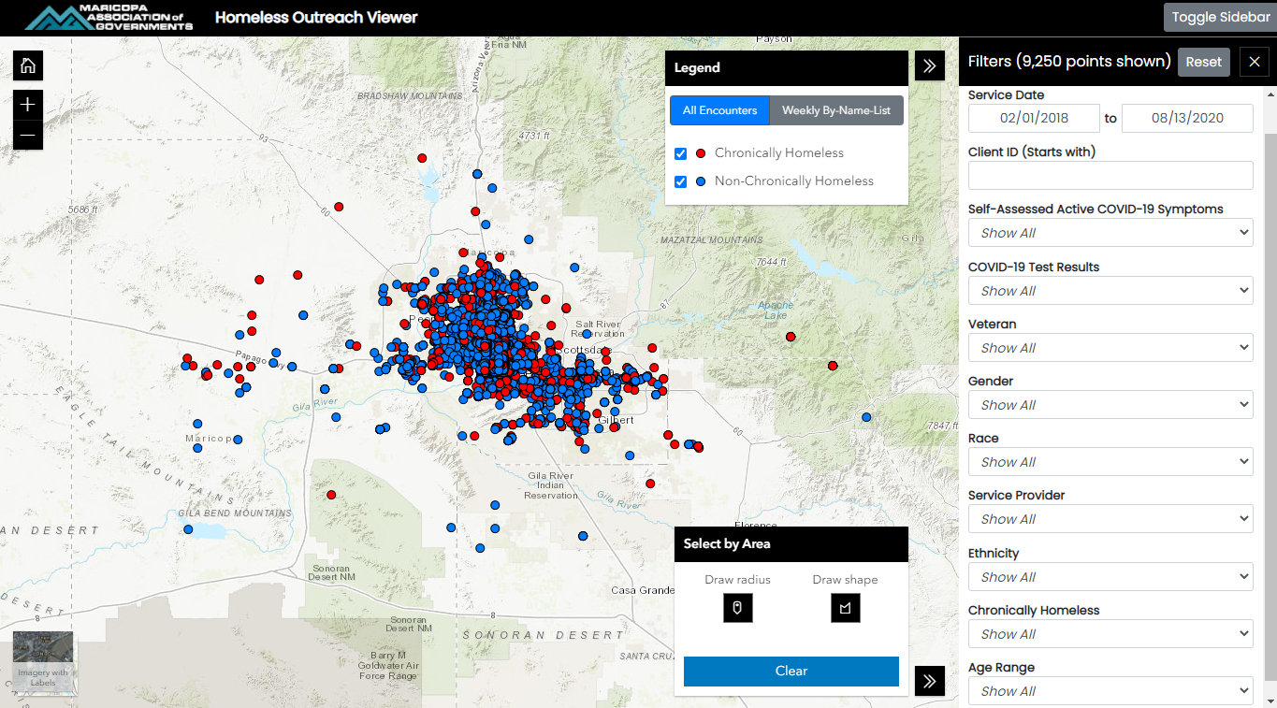
Notes:
This is the initial view once you get past the login screen, only latest encounters of unique individuals are displayed.
The legend window can be toggled between all encounters and weekly targeted outreach with some quick check-box filtering.
The main filters sidebar on the right allows you to choose a specific time period, filter by Covid-19 status, veteran status, service provider and demographic information including age range, race, gender and ethnicity.

Slide 7
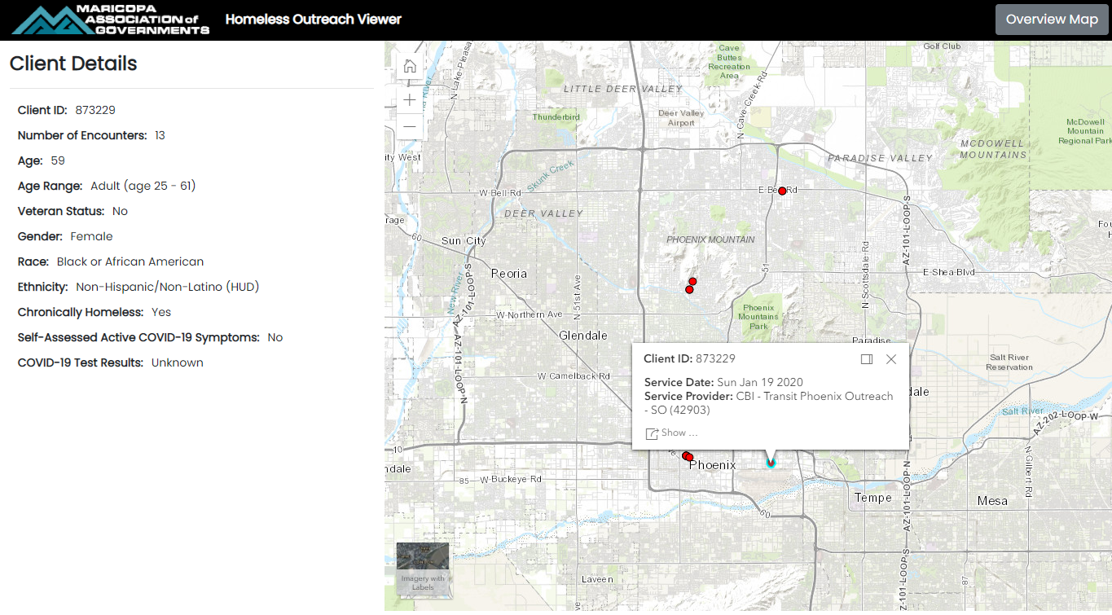
Notes:
Specific clients can be viewed on the “Client Details Page”. All of their outreach encounters can be seen on this page.
Popups are enabled and display the Service Date and Service Provider. Personally identifying information has been excluded from the viewer. The “Client ID” ties back to the HMIS database, Outreach providers are required to have HMIS access in order to be able to obtain a login for the outreach viewer and can refer back to HMIS for additional client details.

Slide 8
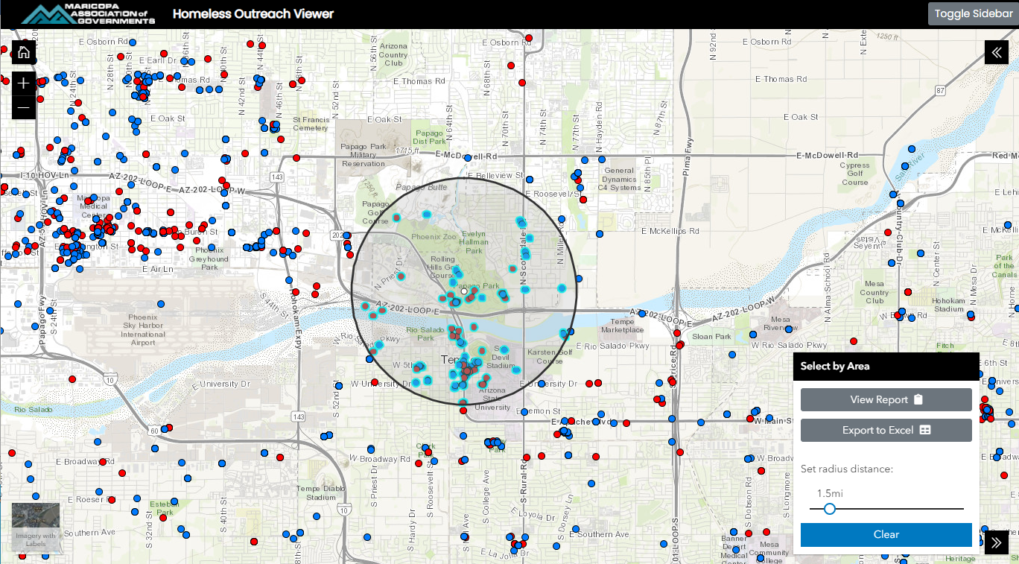
Notes:
A recent enhancement is the select by area tool. Selections can be made by drawing a specific shape or defining a radius distance from a point of origin.
Once a selection is made, a simple chart report can be viewed with options for demographic breakdowns.
The selection can also be exported to an excel file.
Currently, the viewer has filtering and selection capabilities but analysis is done outside of the viewer.

Slide 9
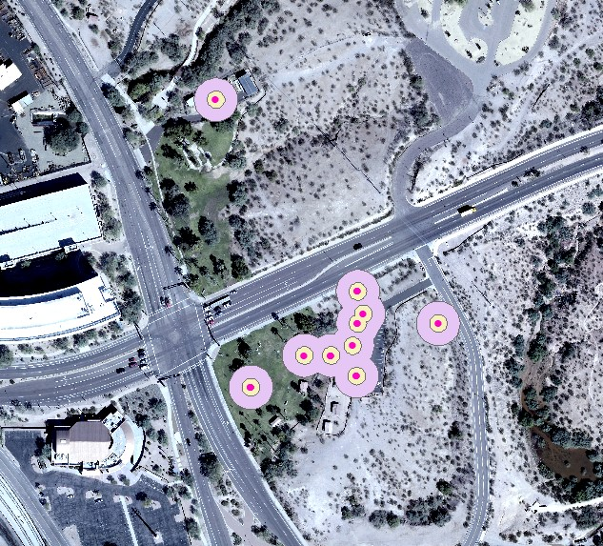
Analysis
Buffered latest
encounters 50’
Ran a spatial join
Reviewed locations
that had 10+
Notes:
In late March, I was asked to use the geotagged outreach data to help assist outreach teams in locating encampments, defined as groups of 10 or more, for targeted outreach.
I used unique individual’s latest encounters for the analysis.
We determined a 50 foot buffer was sufficient to capture known encampments and merged any overlapping buffers.
I then ran a spatial join to see how many of the outreach points fell within the buffers and reviewed the areas that had 10 or more individuals.
While reviewing the results, I realized that there are quality issues with x y coordinates.
A script validates geotags and excludes any points that fall outside of the county but it’s not until analysis like this is run that certain point locations become questionable.

Slide 10
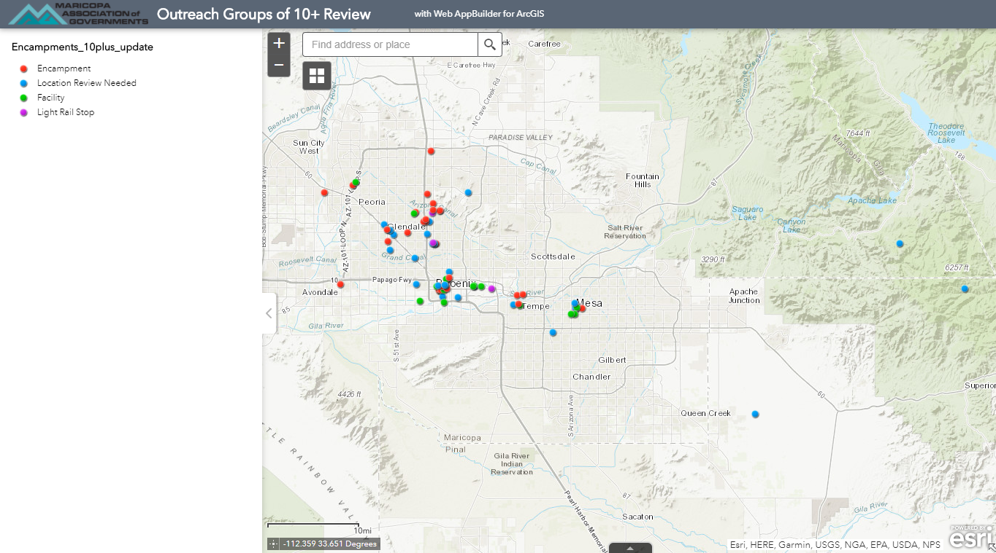
Notes:
To resolve this issue I made a quick web app for outreach teams to review questionable encampment locations.
The BLUE points fell in residential areas or wilderness areas and required location review.
Some of the outreach was conducted inside facilities at magnet events and could be excluded along with light rail stops.

Slide 11
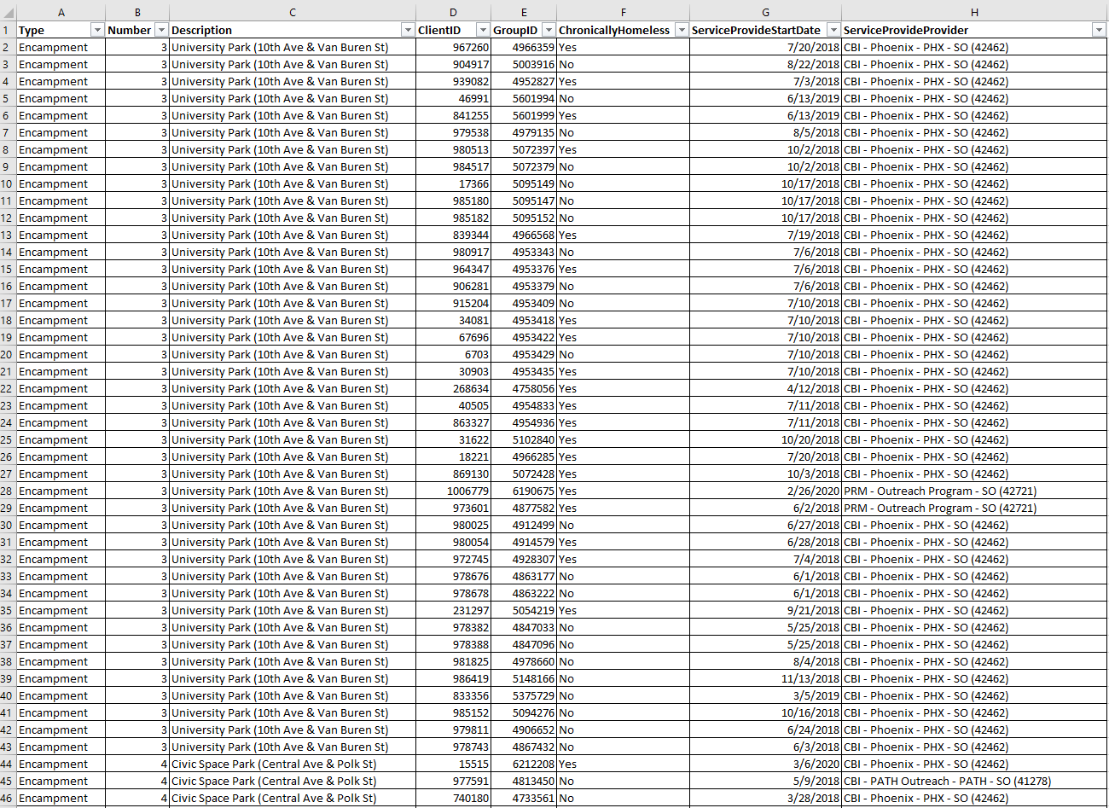
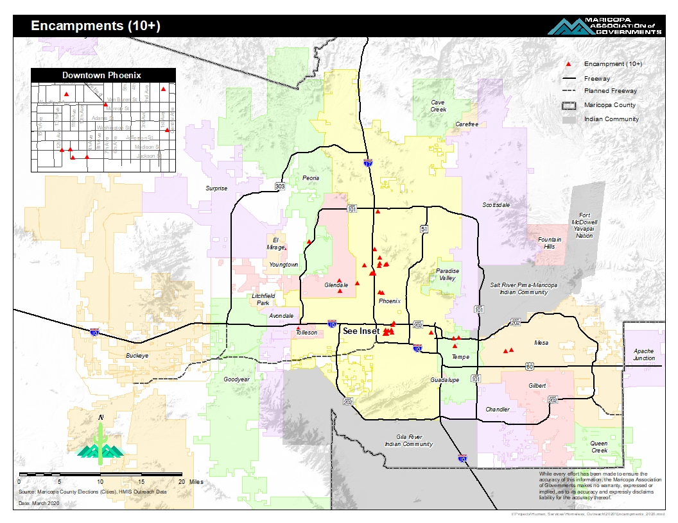
Notes:
Once the questionable locations were corrected by outreach, I ran the analysis again and was able to fulfil the request. I assigned each encampment a unique ID and provided outreach with a spreadsheet of Client IDs located at each encampment. Armed with that information, outreach coordinators were able to determine who was at high risk and how to prioritize targeted outreach for Covid-19 screenings, health education and service connections.
These are the same encampment locations I provided Shiloh.

Slide 12
Questions?
nfunicello@azmag.gov
Notes:
If anyone has any suggestions on a simple and free method for outreach teams to capture x y coordinates in the field, please let me know as we will be suggesting best practice to avoid misplacing points.
Thank you!

